Slide 1
Restaurant Application GitHub Portfolio Project Presentation
Insoo Kim

Slide 2
Part 1: Front-End Architecture, Authentication, And App Diagram

Slide 3
Application Overview Diagram
Stripe
Payment
Credit card payment processing
Web pages for restaurant order management
API end-points for web functions
Strapi
Back-end DB
& Authenticaion
Password authentication & DB for restaurnats, dishes & orders
HTML, React w/ Next.js
Web client
My API
Apollo, GraphQL on Node.js web server
Optional
Firebase
Password
Authenticaion
Google
OAuth2
Authenticaion
Front-end
Middleware
Back-end

Slide 4
Code Overview Diagram
_app.js
<AppContext.Provider>
Head
Layout: Compo., pageProps
register.js
Input: username, email, password
Button: Reg. on Strapi, Firebase
restaurantList.js
<Container> restList w/Card(img, body/text) Button (set restID), renderDishes by restID
1
4
7
context.js
cart: items[], total
add/removeItem()
isAuthenticated
user / setUser()
login.js
Input: email, password
Button: login by Strapi, Firebase, Google
dishes.js
<Col> w/Card(img, body/text) in accordance w/restID,
Button(add item)
2
5
8
layout.js
<Nav>
Home / Sign up/ Sign in
<Container> {props.children}
index.js
Apollo prep.: API_URL, link, client, cache
Apollo ret.: search, rest. list, cart
dishList.js
<Container> dishList w/Card(img, body/text) Button (set restID)
3
6
9

Slide 5
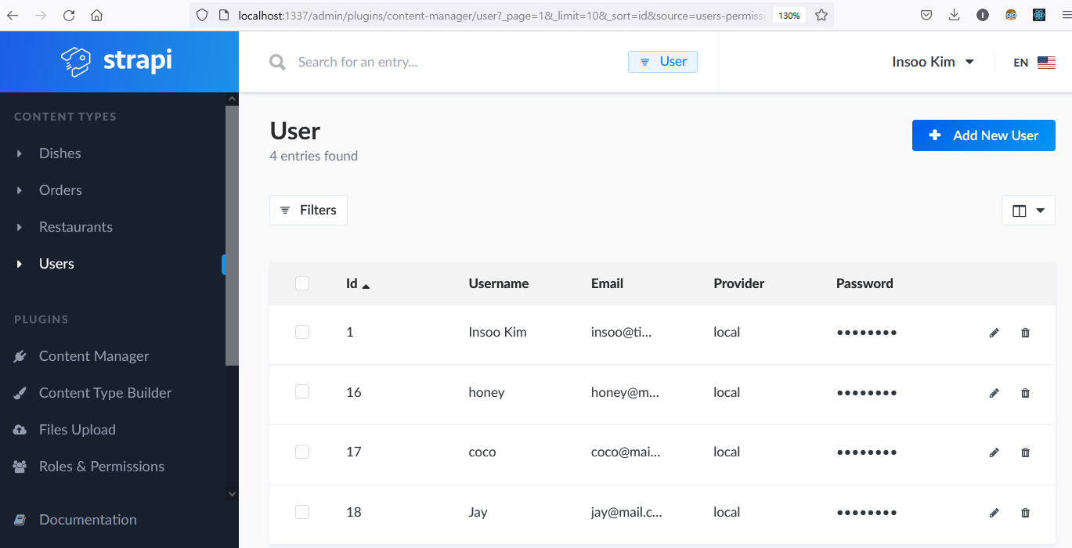
Authentication 1 –Registered Users on Strapi

Slide 6
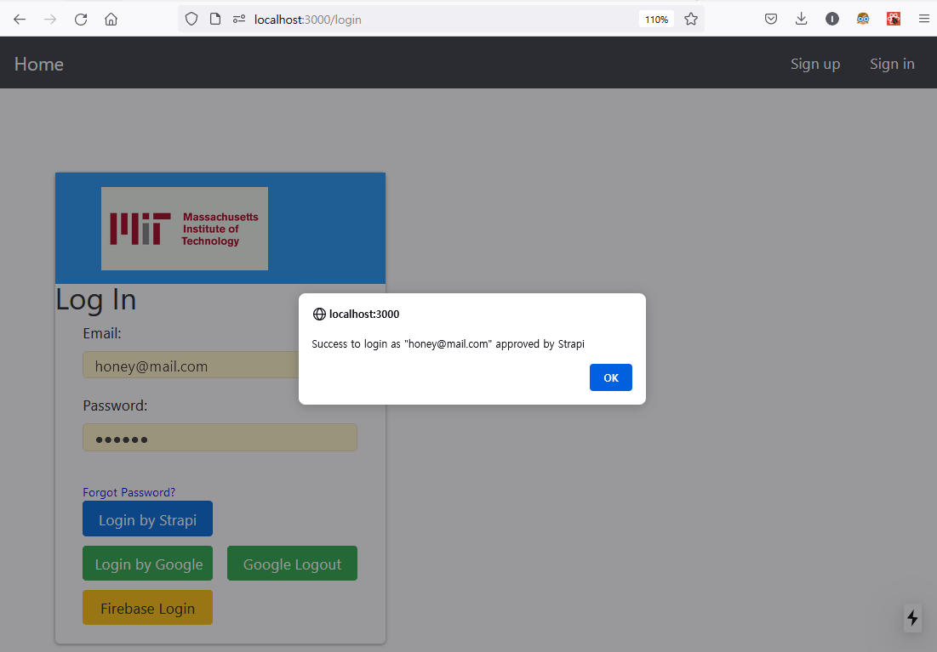
Authentication 2 – Successful Login by Strapi

Slide 7
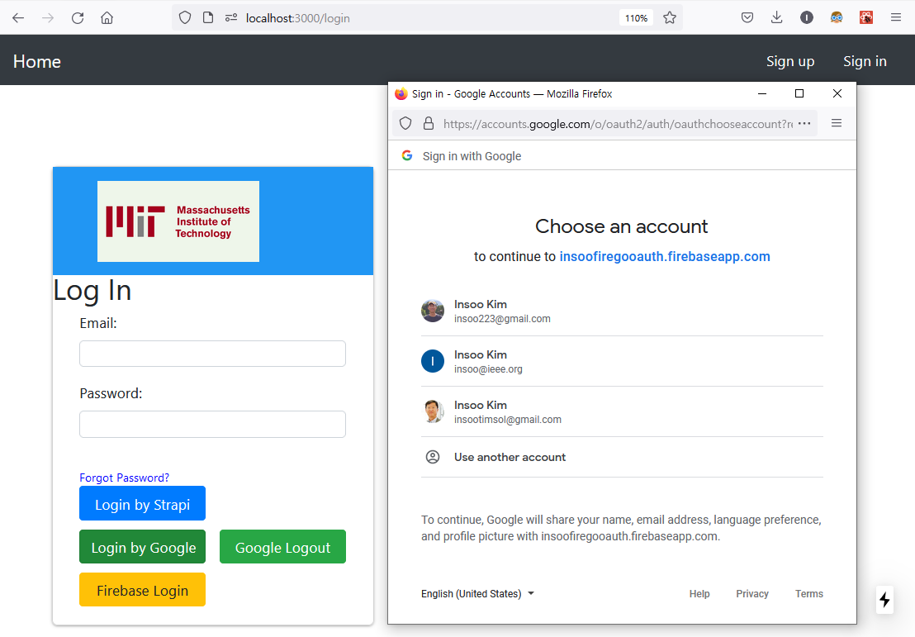
Authentication 3 – Successful Login by Google (1/2)

Slide 8
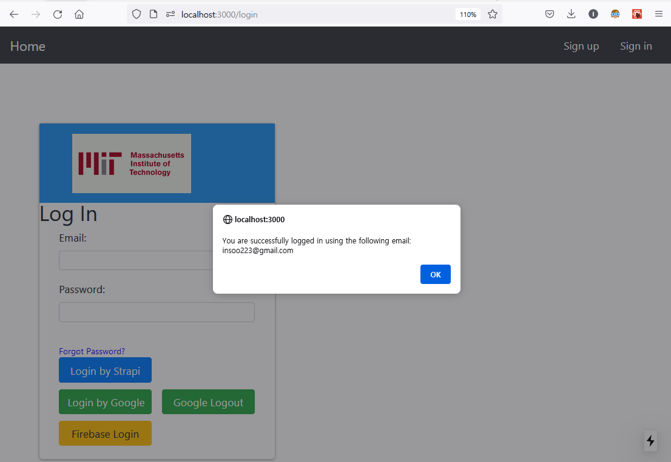
Authentication 4 – Successful Login by Google (2/2)

Slide 9
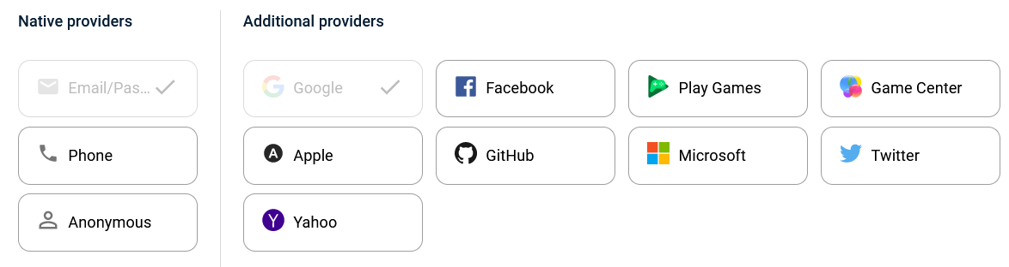
Authentication 5 – Description (1/2): Why choose?
Two+ approaches of authentication & Why choose?
Strapi: account mgmt. integrated w/back-end DB
Google: Easy & secure implementation by Firebase
Firebase: Variety of auth. methods like password, Google, Facebook etc.

Slide 10
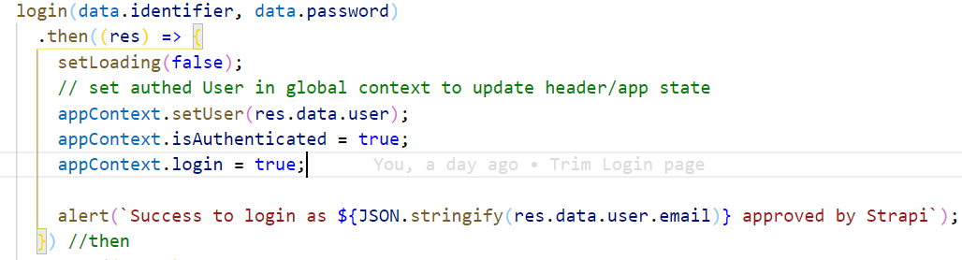
Authentication 6 – Description (2/2): Challenge & Overcome
Challenges & overcome
Strapi: None, for already practiced in the course.
Google & Firebase: Firebase initialization code is different by npm pkg versions. Used firebase@7.24.0 instead of the most current version of 9.x. In near future, will follow up ver.9 for my updated code.
login state mgmt.: React context is not working as my intention.
NOT yet solved.

Slide 11
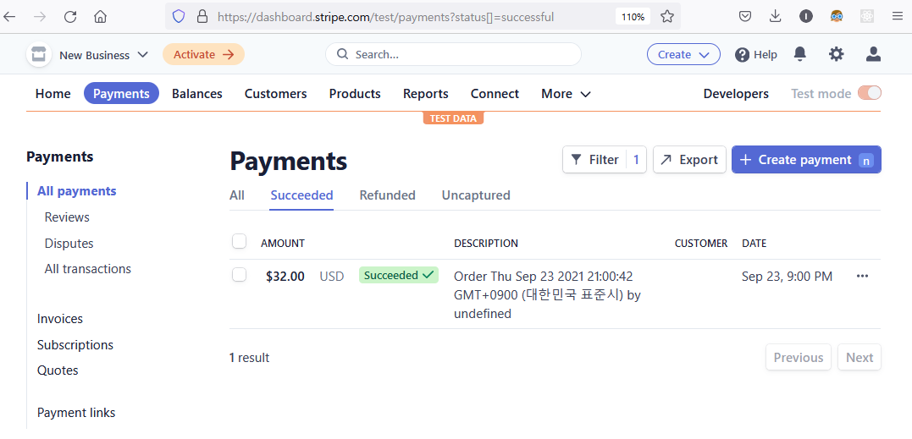
Stripe 1 – Current State of Stripe Payments

Slide 12
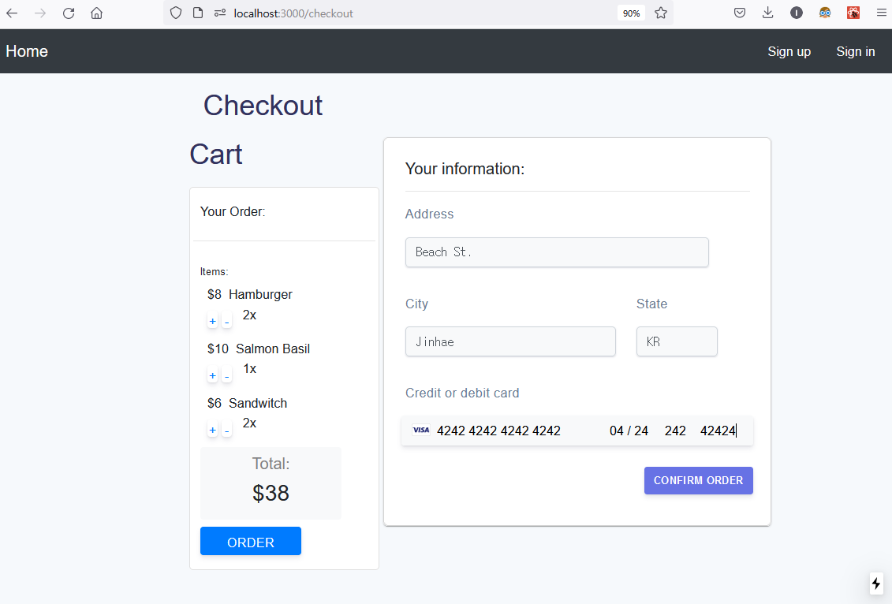
Stripe 2 – Checkout

Slide 13
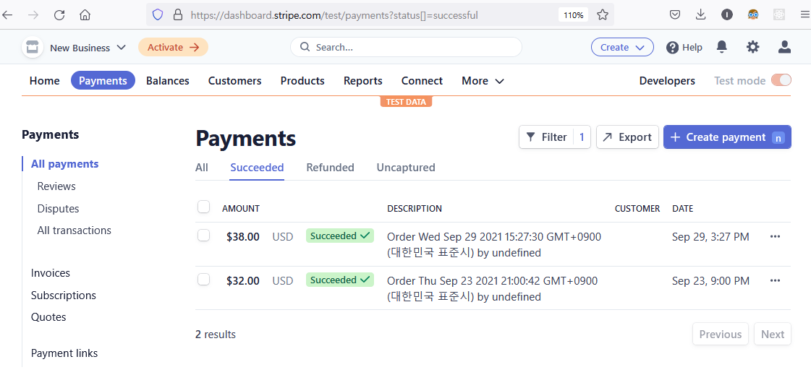
Stripe 3 – Updated State of Stripe Payments
Success!

Slide 14
Stripe 4 – Description (1/3): Payment service provider
Stripe
Easy to implement
Free test mode is available, without incurring any charge.
Dummy card can be used to develop your payment logic.

Slide 15
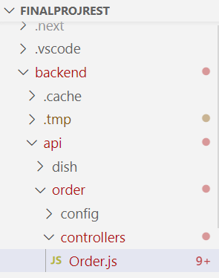
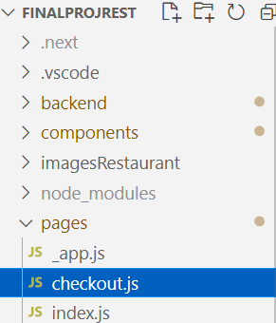
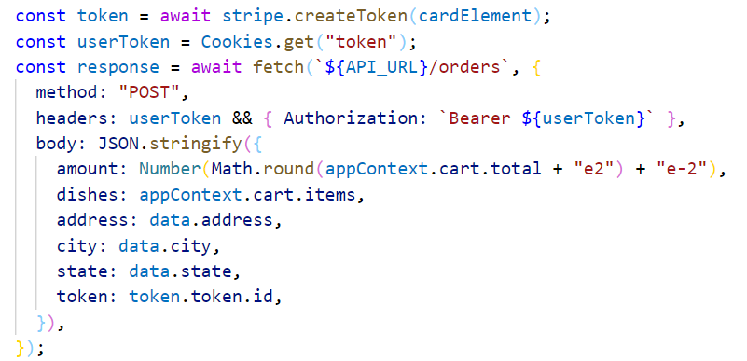
Stripe 5 – Description (2/3): Mechanism
How does it work?
Create Stripe account
Your secret key of Stripe can be found under API keys section.
Set your secret key in /backend/api/order/controllers/Order.js
Set your publishable key in /pages/checkout.js
→ Referring /components/checkoutForm.js, Stripe seems to use JSON Web Token to identify client.

Slide 16
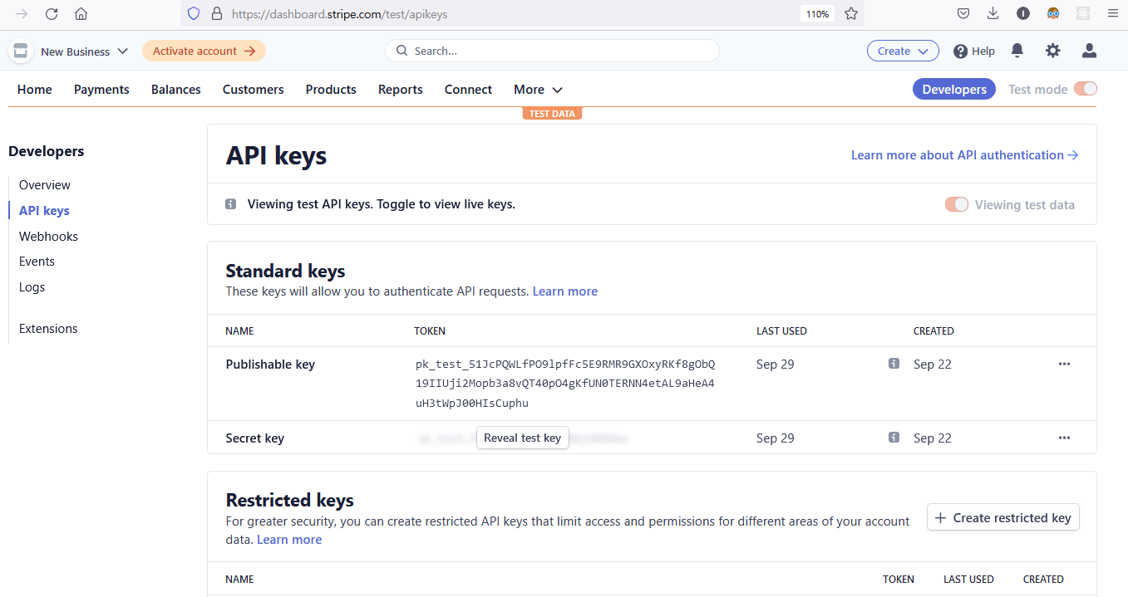
Stripe 6 – Description (3/3): Challenge & Overcome
Challenges & overcome
Stripe surely works as breeze. Even though, payment processing is my first encounter in coding, it works like charm.

